Slide 1
Analyzing African Economic, Banking, and Systemic Crises
S3W
Susan, Tommy, Wilfred, Stan
12.01.21

Slide 2
Dataset Description
This dataset is from Kaggle and a subset of a larger dataset from Harvard Business School.
Features economic and financial crises data from 13 African Countries from 1860 to 2014.
There are 1,059 observations across 14 columns including the year recorded and if a systemic, currency, or other crisis occurred that year.
Most data is binary.

Slide 3
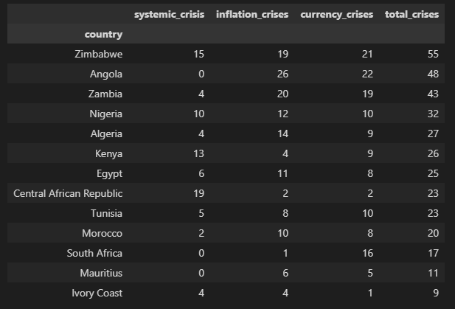
Exploratory Data Analysis
Zimbabwe, Angola, and Zambia had the most crises over the observed time frame.

Slide 4
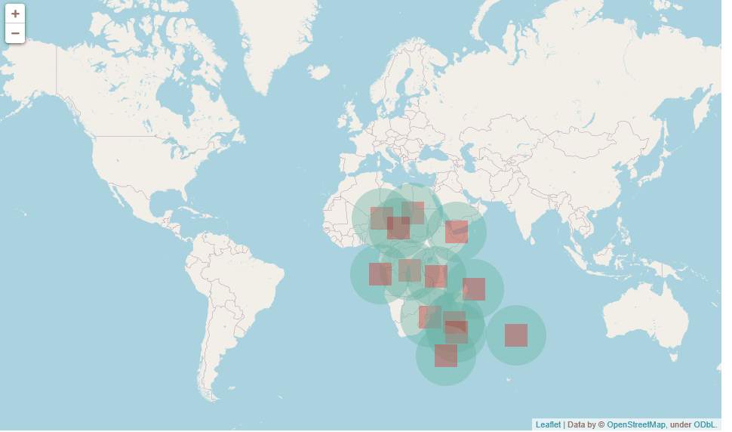
Mapping Countries & Crises

Slide 5
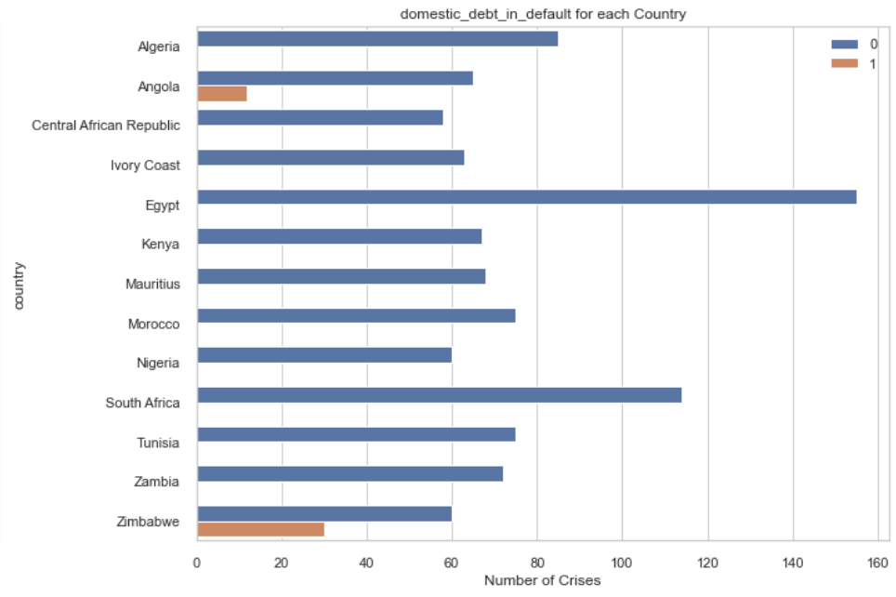
Domestic Debt in Default
Angola and Zimbabwe are the only countries with domestic debt among the observed countries.

Slide 6
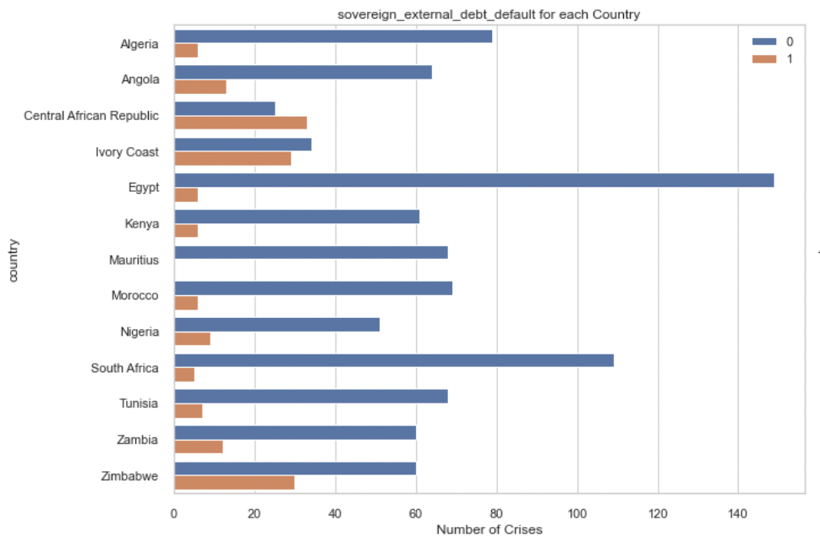
External Debt Comparison
Mauritius is the only country without external debt.

Slide 7
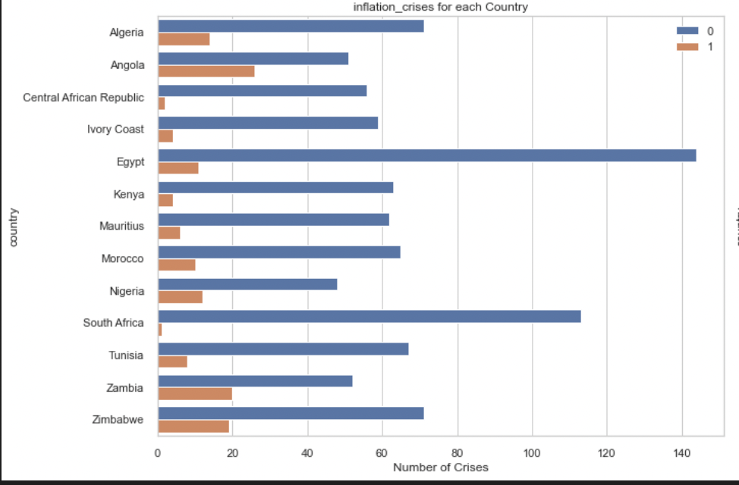
Inflation Crises Comparison
South Africa had the least inflation crises among the countries.

Slide 8
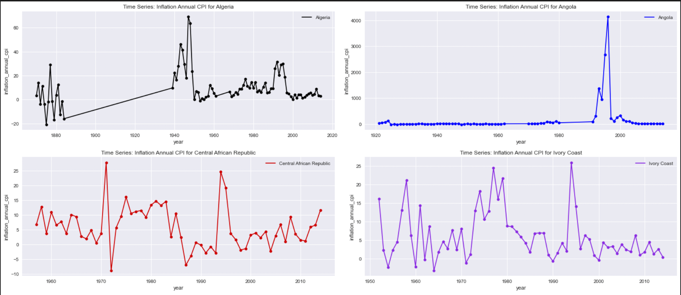
Inflation CPI Comparison
Angola had the highest peak of inflation CPI of 4000 in the late 90s.

Slide 9
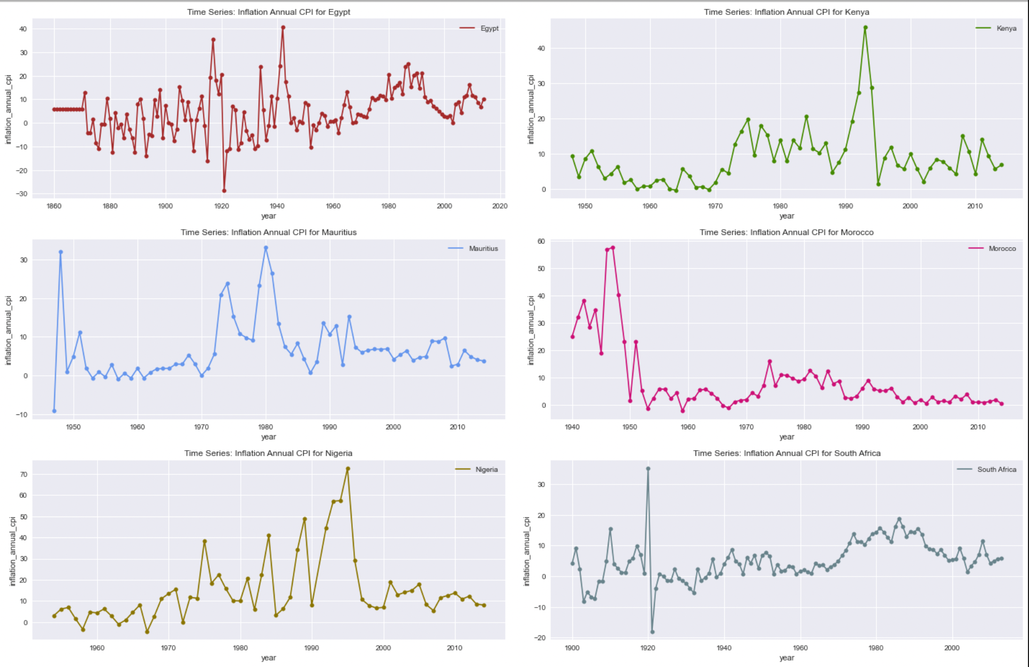
Inflation CPI Comparison Contd.
Inflation Annual CPI for other countries.

Slide 10
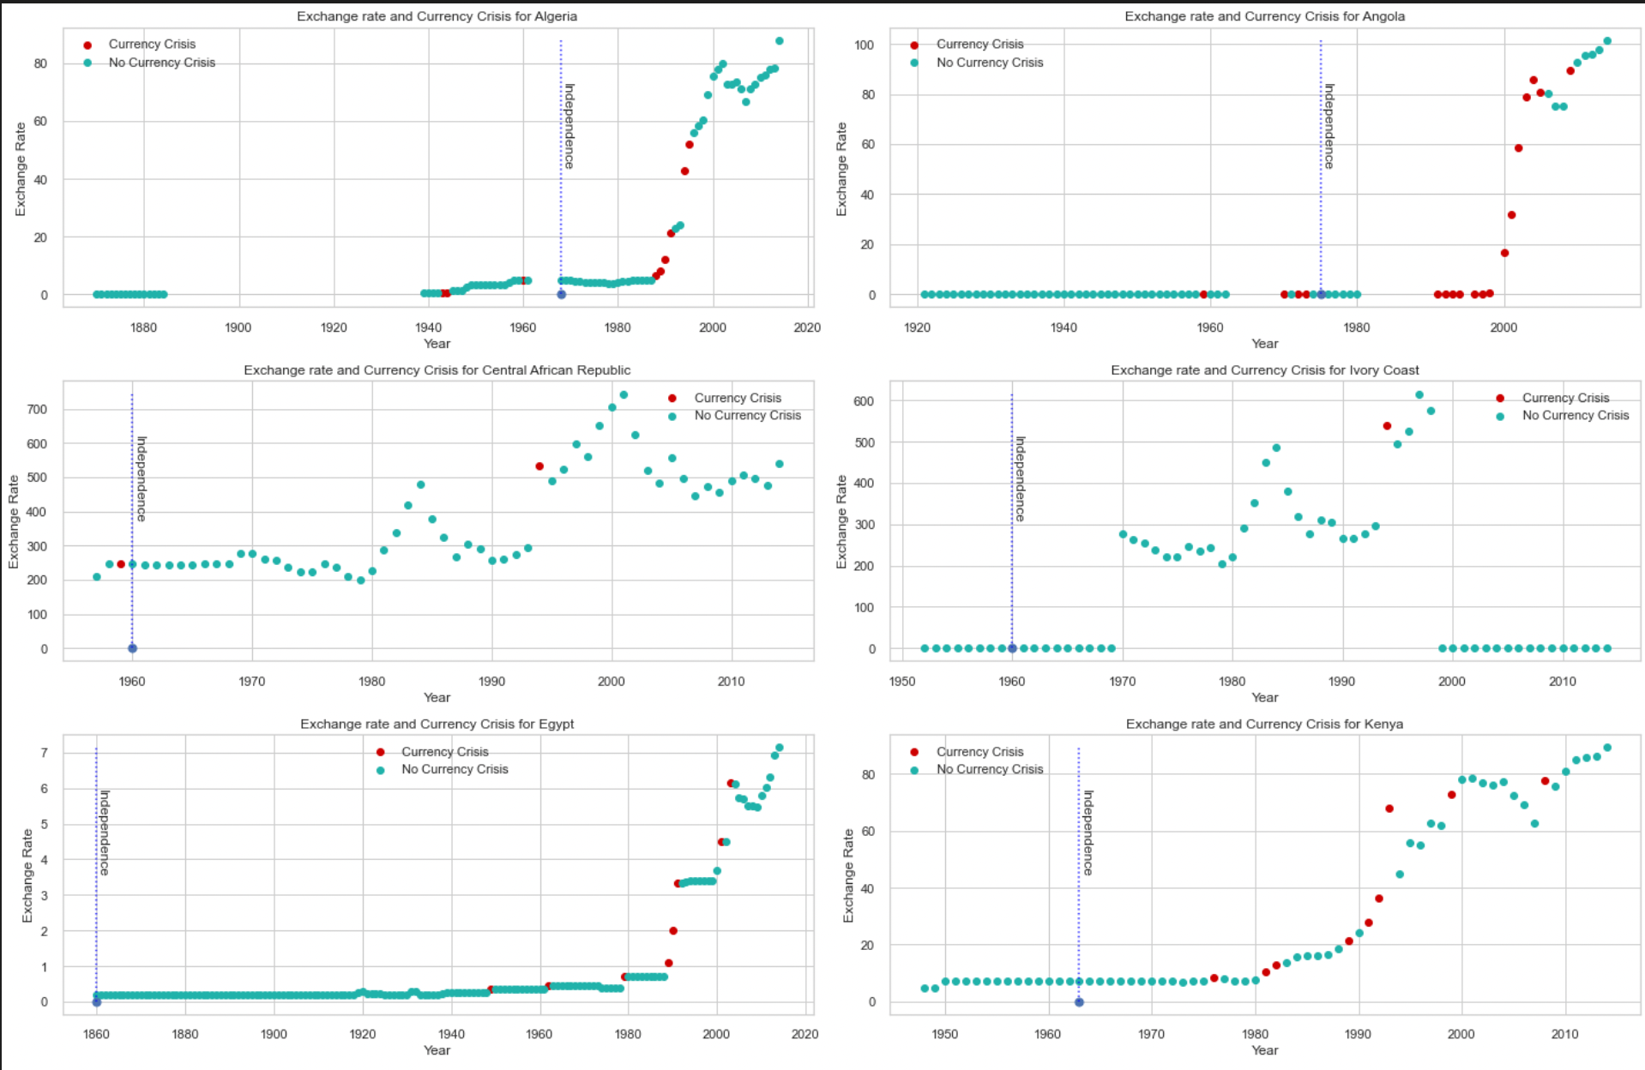
Exchange Rate Comparison
Exchange rate increased for most countries after independence.
Angola had the most frequent currency crisis with fast increasing exchange rate between 1990 to early 2000s.
CAR had the highest exchange rate of 700 in early 2000s.

Slide 11
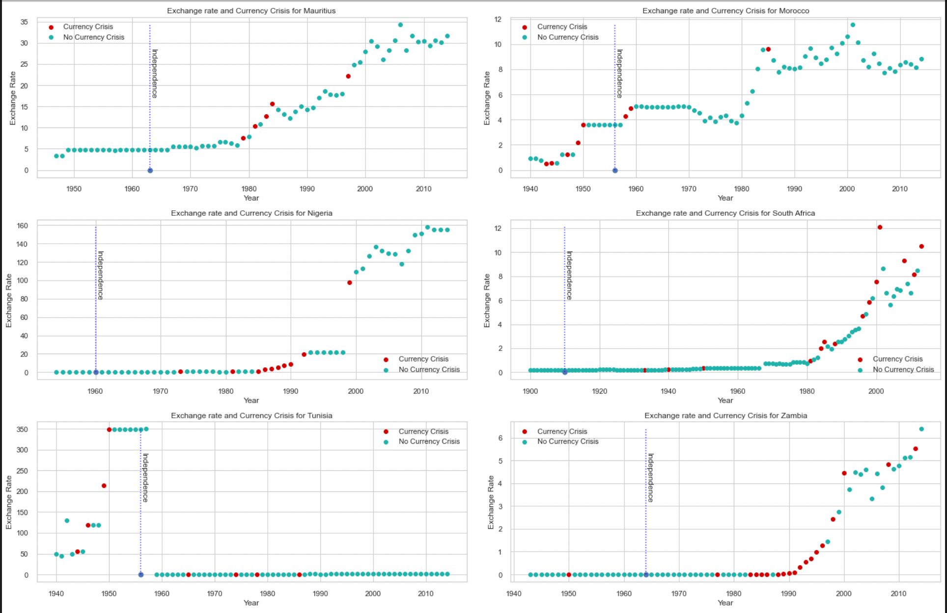
Exchange Rate Comparison Contd.
Nigeria had a sharp exchange rate increase from 20 to 100 in year 1999 with currency crisis occurring same year.
Zambia had the most consecutive occurrence of currency crisis between late 1980s to 2000.

Slide 12
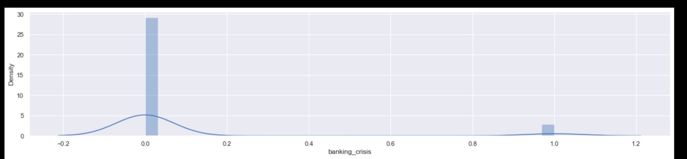
Banking Crisis Density

Slide 13
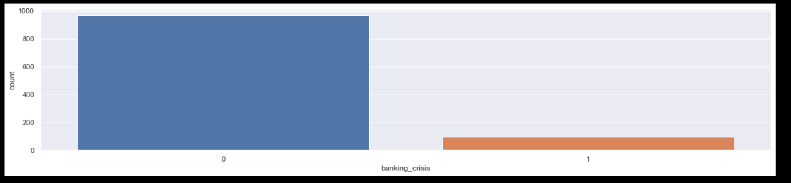
Banking Crisis Count

Slide 14
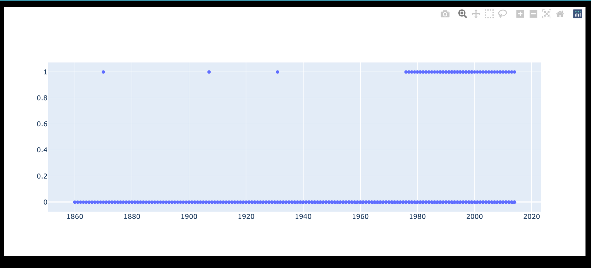
Systemic crisis yearly frequency
Systemic Crisis - y axis
Year

Slide 15
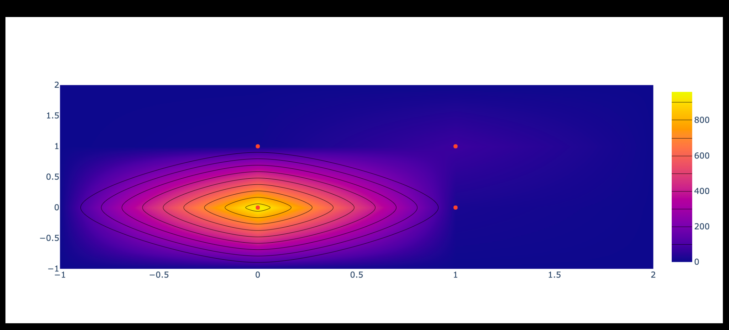
Banking Crisis and Systemic Crisis Correlation
Systemic Crisis - y axis
Banking crisis

Slide 16
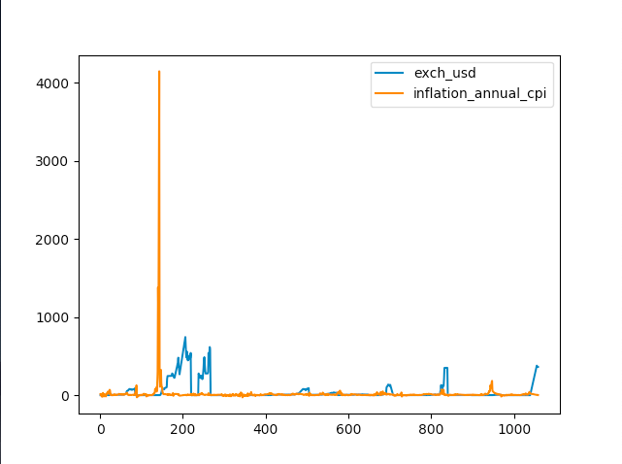
Feature Engineering
Relevant Continuous Features:
Exchange rate
Annual Inflation CPI (Customer Price Index)

Slide 17
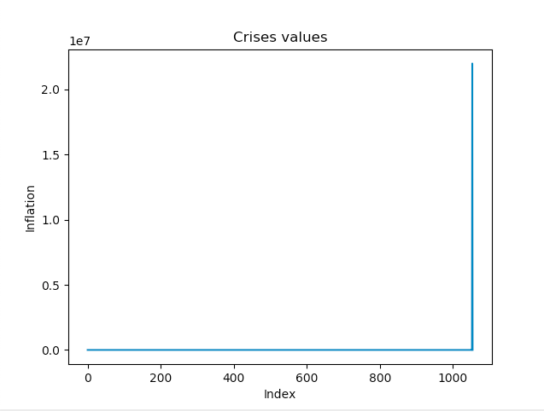
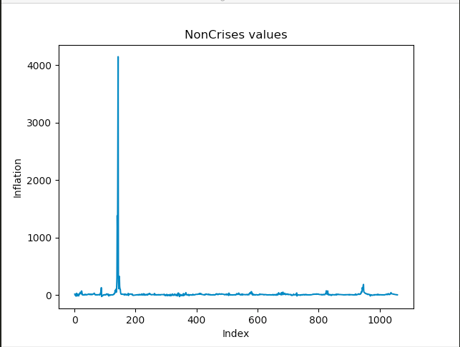
Feature Engineering

Slide 18
Feature Engineering
In need of Feature EngineerIng?
Yes
Max:21989695.22
Min: -7.67
Max: 4146.01
Min: -28.50213688

Slide 19
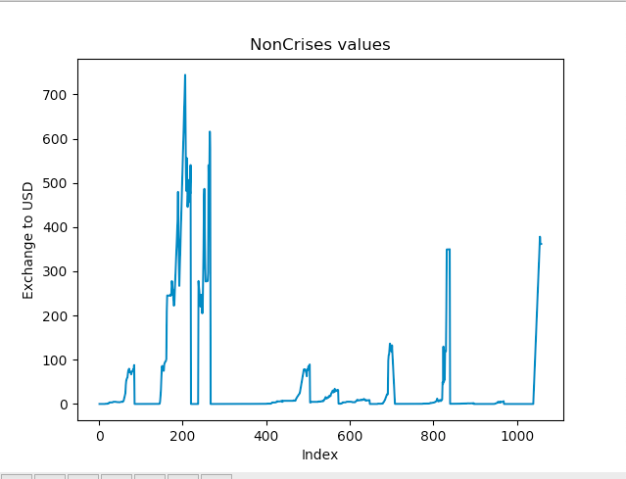
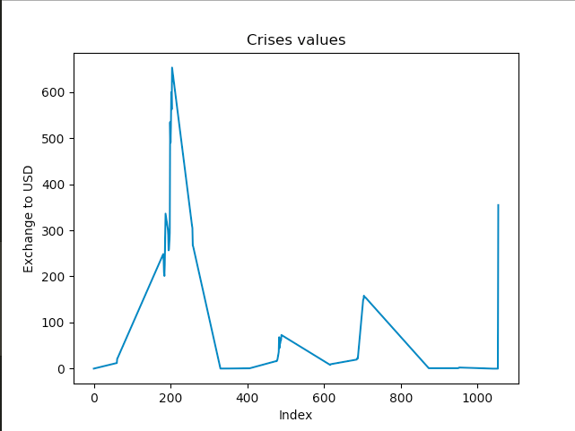
Feature Engineering

Slide 20
Feature Engineering
In need of Feature EngineerIng?
No
Max: 652.9534143
Min: 9.31e-26
Max: 744.3061387
Min: 0.0

Slide 21
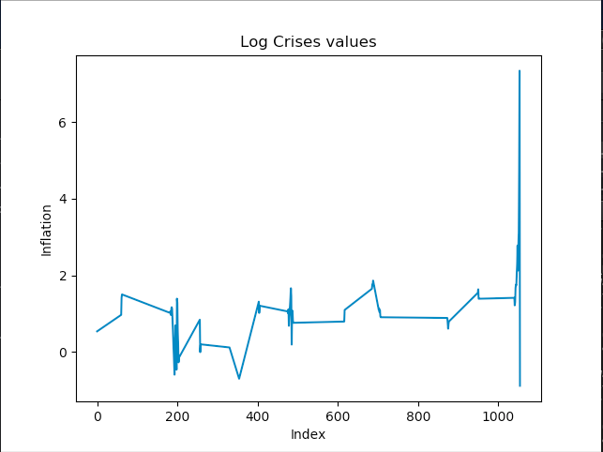
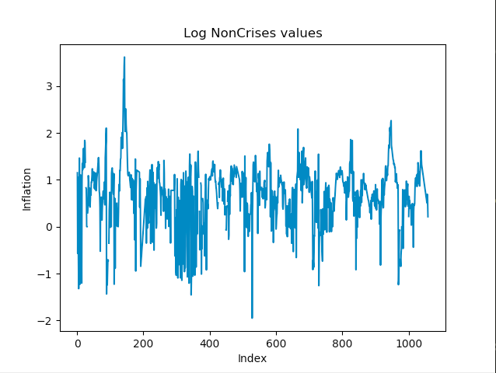
Feature Engineering
Let’s Apply Log Normalization/Transformations of Inflation

Slide 22
[Sherlock Holmes:] “The temptation to form premature theories upon insufficient data is the bane of our profession.”
— Arthur Conan Doyle

Slide 23
Thank You!

Slide 24
Appendix

Slide 25
Project Steps
Form a team and search Kaggle for a dataset.
Select a dataset and share with the group for feedback.
Identify common platform for coding (VS Code and GitHub).
Load dataset and perform summary statistics and visual data inspection.
Explore the data through charts and graphs.
Analyze the data and determine next steps.

